Slide 1
PSYC100 GENERAL PSYCHOLOGY
TREATMENTS AND THERAPIES

Slide 2
Learning Outcomes
Biological treatments
Psychodynamic therapies
Humanistic therapies
Cognitive therapies
Behavioural therapies

Slide 3
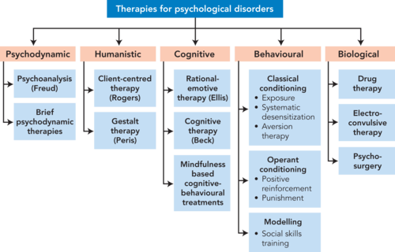
Major Approaches to Treatment
Other examples: EMDR, ACT, Schema, DBT, Gestalt, Existential, Attachment-based, couples therapy, sex therapy, family therapy etc.

Slide 4
I - Biological Approaches
Drug Therapies:
  Most commonly used biological interventions
  Psychopharmacology: the study of how drugs affect cognitions, emotions, and behavior
Three major categories:
  Antipsychotic drugs
  Antianxiety drugs
  Antidepressant drugs

Slide 5
A) Drug Therapies
Antipsychotic Drugs:
  Decrease action of dopamine
  Reduce positive symptoms of schizophrenia (e.g. delusions and hallucinations)
  Little effect on negative symptoms

Slide 6
Drug Therapies
Antianxiety Drugs:
  Designed to reduce anxiety without affecting alertness or concentration
  Side effects: drowsiness, lethargy, concentration difficulties, dependence

Slide 7
Drug Therapies
Antidepressant Drugs:
  Four classes:
    Tricyclics
    Monoamine oxidase (MAO) inhibitors
    Selective serotonin reuptake inhibitors (SSRIs)
    Seratonin norepinephrine reuptake inhibitors (SNRIs)

Slide 8
Drug Therapies
Antidepressant Drugs (continued):
  Tricyclics and MAO inhibitors:
    Increase activity of norepinephrine and serotonin
    MAOs more severe side effects

Slide 9
Drug Therapies
Antidepressant Drugs (continued):
  SSRIs:
      Increase activity of serotonin
      Milder side effects than other antidepressants
      Reduce depressive symptoms more rapidly
  SNRIs:
      Increase Serotonin and NE

Slide 10
Drug Therapies
Criticisms of Drug Treatments:
  As much as 90% of effects may be placebo effects
  Do not “cure” the disorder
  Do not teach client coping and problem solving skills to deal with life problems
  High relapse rate

Slide 11
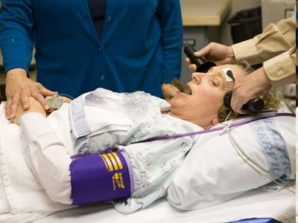
B) Electroconvulsive Therapy
Patient is given a sedative and a muscle relaxant
Patient is placed on padded mattress, where electrodes are attached to scalp
Brief shock (less than one second) is applied, causing a seizure of the CNS
Short-term effects: headache, sore muscles, confusion

Slide 12
Electroconvulsive Therapy
Useful in treating severe depression, particularly if there is a high risk of suicide
  Effects can be immediate
  No one knows why it works
  Used primarily in patients with major depression who cannot take or do not respond to medication

Slide 13
Electroconvulsive Therapy
Criticisms of ECT:
  Possibility of relapse is high
  Possibility of permanent memory loss
  Possibility of permanent brain damage

Slide 14
C) Psychosurgery
Psychosurgery: surgical procedures that remove or destroy brain tissue in an attempt to change disordered behavior
  Used rarely, as a last resort

Slide 15
II - Psychodynamic Therapies
Focus on internal conflicts and unconscious factors that underlie maladaptive behavior
Goal is to help clients achieve insight
  Insight: the conscious awareness of the psychodynamics that underlie their problems

Slide 16
Psychodynamic Techniques
Free Association: clients verbally report without censorship any thoughts, feelings, or images that enter their awareness
  Provides clues about important themes and issues
Dream Interpretation: dreams express unconscious dreams, fantasies, and wishes
  Analyst helps client interpret the symbolism in the dream

Slide 17
III - Humanistic Psychotherapies
Humanists view people as capable of consciously controlling their actions
  People should take responsibility for their own choices and behavior
  Everyone possesses inner resources for self-healing and personal growth
  Focus is primarily on the present and future instead of the past

Slide 18
Humanistic Psychotherapies
Person-Centered Therapy/Client-Centered Therapy (Carl Rogers) : three important therapist attributes:
  Unconditional Positive Regard: communicated when the therapist shows that he or she genuinely cares about and accepts the client, without judgment or evaluation
  Empathy: willingness and ability to view the world through the client’s eyes
  Genuineness: consistency between the way the therapist feels and the way he or she behaves

Slide 19
IV - Cognitive Therapies
Focus on the role of irrational and self-defeating thought patterns
  Therapists try to help clients discover and change the cognitions that underlie their problems
  Thought patterns are not unconscious, but they can be automatic and ingrained

Slide 20
Cognitive Therapies
A - Rational-Emotive Behavioural Therapy (Albert Ellis): ABCD Model
  A: the activating event that seems to trigger the emotion
  B: the belief system that underlies the way in which a person appraises the event
  C: the emotional and behavioral consequences of that appraisal
  D: disputing (challenging) erroneous belief systems

Slide 21
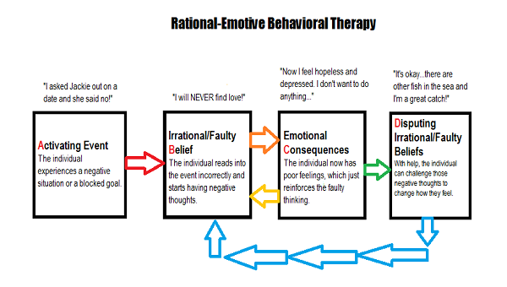

Slide 22
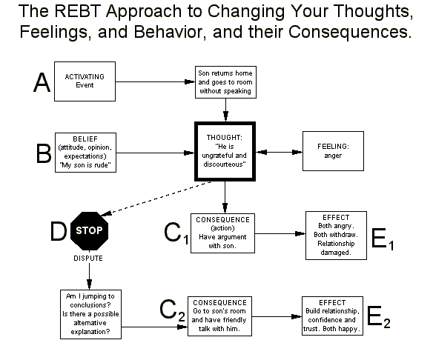

Slide 23
Cognitive Therapies
B - Cognitive Therapy (Aaron Beck): goal is to identify faulty/negative automatic thoughts and to help clients change these thought patterns
    For example, “I am worthless and cannot do anything right” thought in depression.
    The “Negative Triad”
  Help clients realize that their thoughts, and not the situation, cause their maladaptive emotional reactions

Slide 24
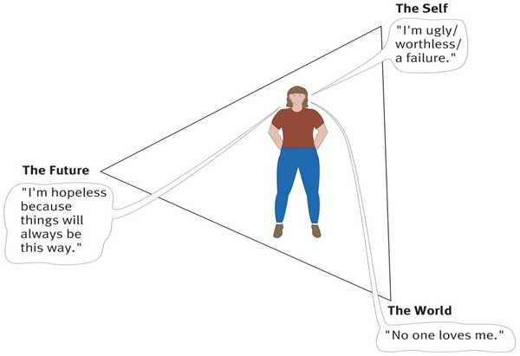

Slide 25
Cognitive Therapies
C – Cognitive Behavioural Therapy: CBT is a widely used, evidence-based form of talk therapy that helps people manage problems by changing the way they think (cognitions) and behave.
It is based on the concept that our thoughts, feelings, and behaviors are interconnected. Negative or distorted thought patterns can lead to emotional distress and unhelpful behaviors, creating a vicious cycle.
CBT focuses on identifying and challenging these unhelpful thoughts, replacing them with more balanced and realistic ones, while also encouraging healthier behavioral changes.
Uses the ABC model
E.g. Someone with social anxiety is invited to a work party.
A (Activating Event): You arrive at the party and notice a group of colleagues talking, but no one immediately approaches you to chat.
B (Belief): "They think I'm boring and awkward. Everyone here dislikes me, and I'll never fit in. This proves I'm unlikeable."
C (Consequence): Emotional: Intense anxiety, embarrassment, or shame. & Behavioral: You leave the party early, avoid eye contact, or stand alone in a corner.

Slide 26
V - Behavior Therapies
Behavioral approaches believe that:
  Maladaptive behaviors are not merely symptoms of underlying problems
    The behaviors are the problem
  Problem behaviors are learned in the same ways normal behaviors are
  Maladaptive behaviors can be unlearned by applying classical conditioning, operant conditioning, and modeling principles

Slide 27
Behavior Therapies
A - Exposure Therapy
  Treat phobias through exposure to the feared stimulus
  Highly effective for reducing anxiety responses
  Systematic desensitization and Flooding

Slide 28
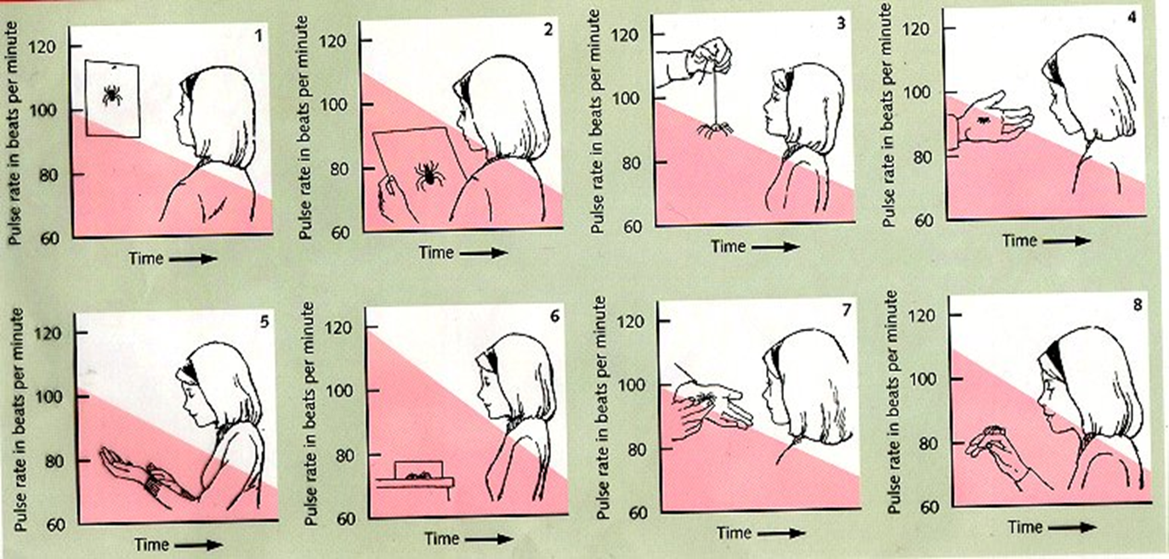

Slide 29
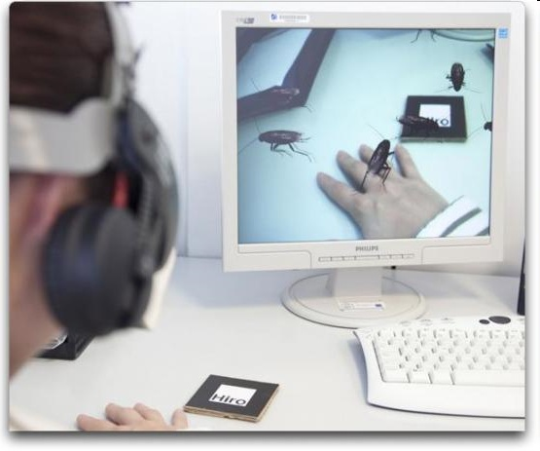
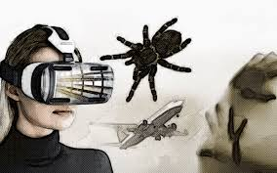

Slide 30
Behavior Therapies
B - Aversion Therapy: the therapist pairs a stimulus that is attractive to the client with a noxious stimulus in an attempt to condition an aversion to the stimulus
  Examples: alcohol, pedophiles
  More effective if paired with a comprehensive treatment program

Slide 31
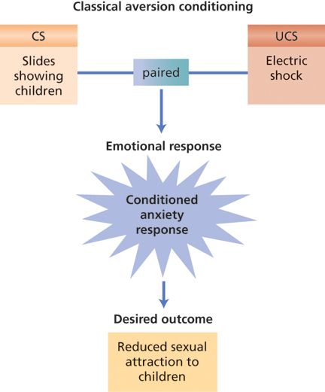
Behavior Therapies

Slide 32
Malcolm McDowell in a scene from A
Clockwork Orange. His eyes are clamped open, forcing him to watch a film portraying acts of violence and sadism, as part of aversion therapy. He’d earlier been
given an emetic drug, so that extreme nausea and violence will become associated.

Slide 33
Behavior Therapies
C - Token Economy
  System for strengthening desired behaviors through the systematic application of positive reinforcement
    Tokens are given for desirable behaviors; they can then be exchanged for tangible reinforcers
    Very effective in a wide variety of situations

Slide 34
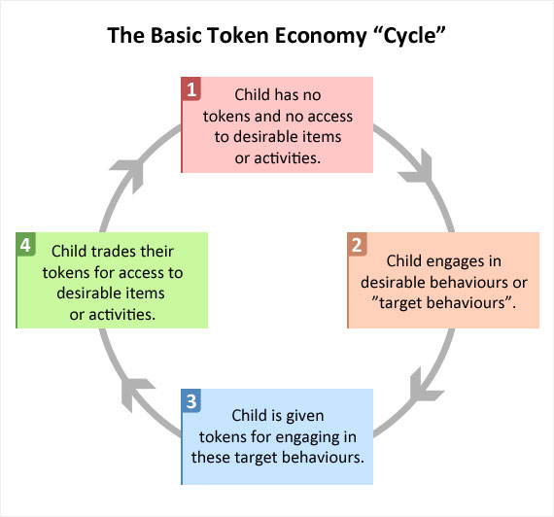

Slide 35
Lecture summary
What are biological treatments (e.g. drug treatment)? Psychodynamic therapies? Humanistic therapies? Cognitive therapies? Behavioural therapies?

